Slide 1
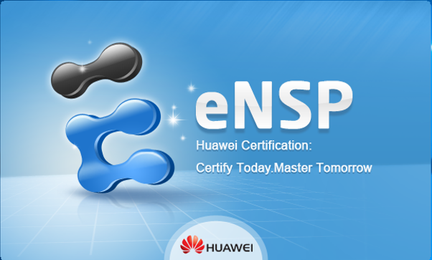

TEB1063 (CS)
TFB1093 (IT)
DATA COMMUNICATION
AND NETWORK
PROJECT

Slide 2
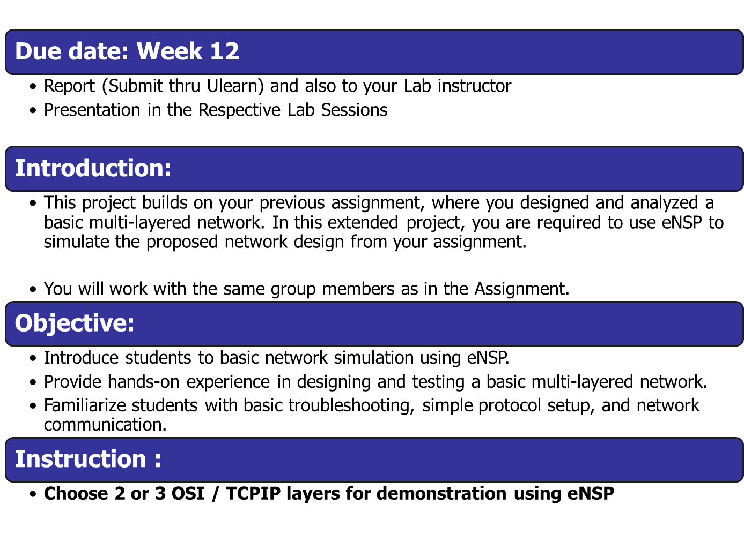

Slide 3
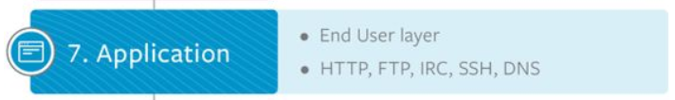
Task
Set up a basic client-server communication scenario in eNSP.

Slide 4
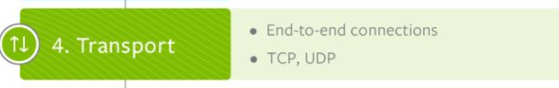
Task
Use TCP for a reliable communication setup
Configure basic TCP connections between simulated devices to understand reliable data transfer.
Demonstrate simple flow control by limiting the data rate and observing its effects.
Simulate a packet drop scenario to show how TCP handles retransmissions.

Slide 5
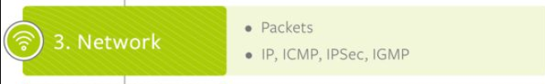
Task
Create a basic network topology using eNSP with 2-3 routers and multiple hosts.
Use static routing for simplicity, with clear steps on how to configure it in eNSP.
Implement a simple addressing scheme (e.g., IPv4) and explain how devices communicate using assigned IPs.
Demonstrate basic packet forwarding between routers and connected devices.

Slide 6

Task
Data Link Layer (Optional – extra marks)
  Extend your design to the Data Link Layer, focusing on how data is transmitted over a physical medium.

Slide 7
Deliverables
eNSP Demo:
  Students must demonstrate a simple, working network in eNSP, explaining how things work,
Presentation:
  Focus on explaining the network design, basic configurations, and protocol choices or any related info to share.
Report

Slide 8
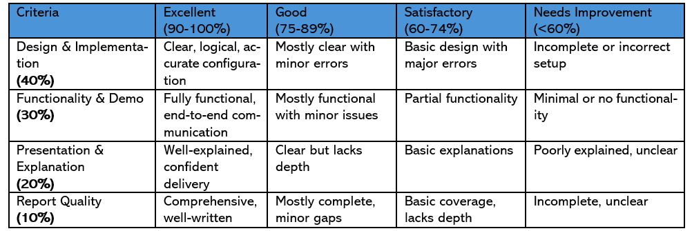
Evaluation Criteria

